Slide 1
Web Mining Final Project Emotion Analysis from Tweets. Tegjyot Singh Sethi T0seth01@louisville.edu Ranjith Kumar Nandella Nandella.ranjithkumar@gmail.com

Slide 2
Introduction
The goal of this project is to Analyze Tweets to classify them as either having a Positive or a Negative emotional undertone.
Classification done solely based on the text in the tweets.
Trying to find a relationship between the use of certain words and the mood of the user.
Major challenges: Tweets tend to be messy and Short
Most of the documents will end up becoming highly sparse vectors and hence might not lead to any useful information.

Slide 3
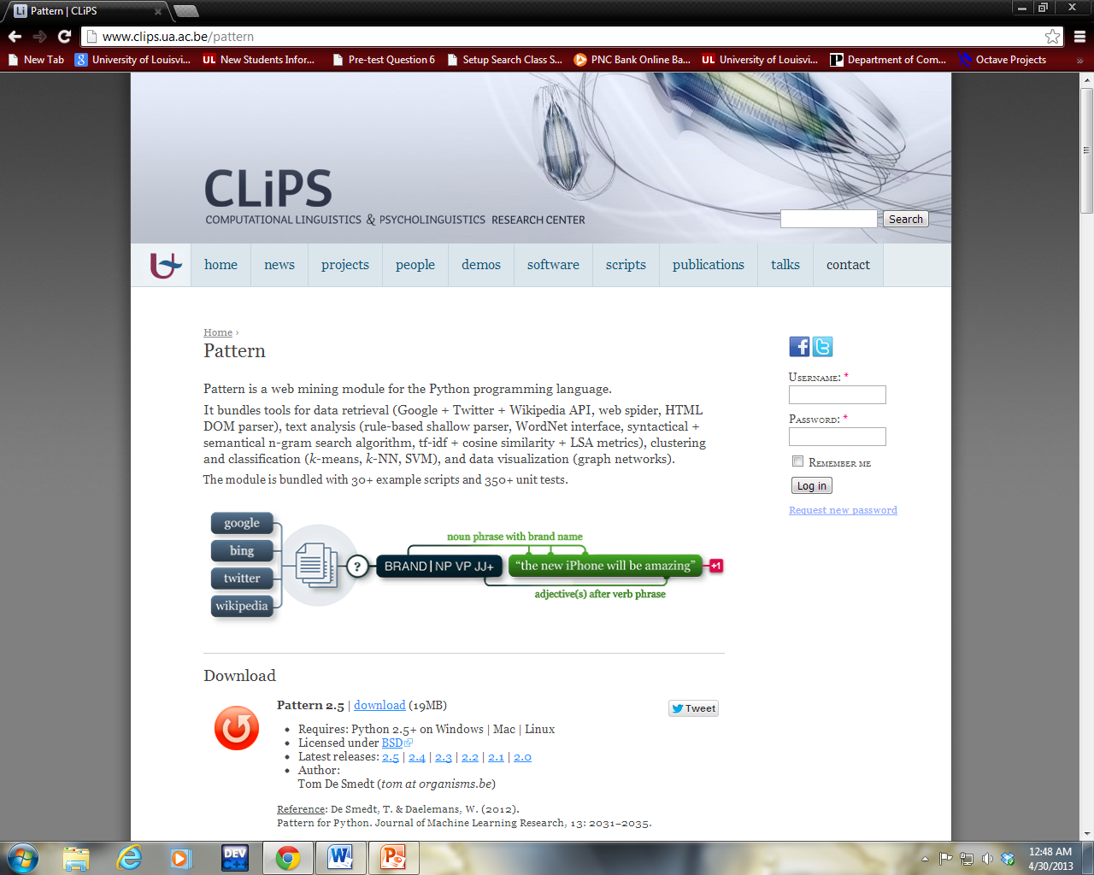
Tools Used
Pattern, Python, Weka, Matlab

Slide 4
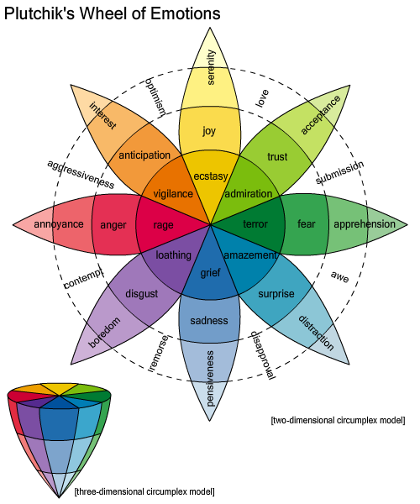
Motivation

Slide 5
Data Used
Twitter Data Stream queried for a week. Search based on any of the below mentioned hashtags.
Positive Emotions:
#joy, #happy, # bliss , #ecstasy, #merry
Negative Emotions:
#sad, #gloomy, # depressed, #mourn, #despair.
The resulting tweets are sorted and duplicates are removed. The resulting files now have the following size:
Positive Tweets: 22088; Negative Tweets: 16175

Slide 6
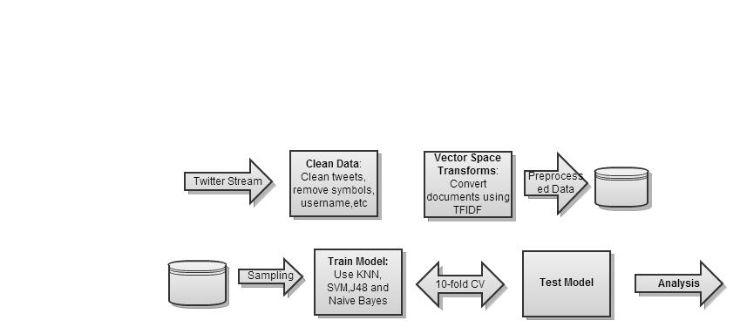
Architecture of the System
Objective: Analyzing Tweets to classify them as either having a Positive or a Negative mood.

Slide 7
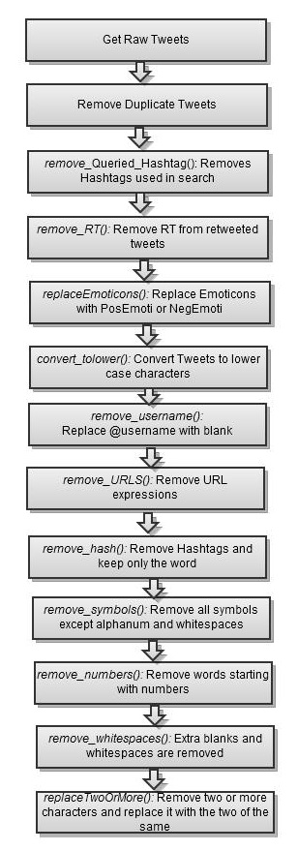
Preprocessing (Data Cleaning)
Descriptive Text | Symbols
PosEmoti | :), :-),:o), :],:3,:c),:D, C:, ;), :},:8
NegEmoti | :'(,;(,',D:, :{, :<, :-D, ', v.v, DX,D=,D;,D8,:C,:c , :-(, :(,
Heart | '<3'
BrokenHeart | '</3'

Slide 8
Preprocessing (Data Cleaning)
Sample Tweet
Raw:
How to Avoid the and #Discouragement of Long Term #JobLoss. http://t.co/1RuLoLPg62 #Depression #Networking #HiddenJobMarket How to deal with #pessimism and even in the midst of hardship, with @carter_phipps: http://t.co/RrRfpmCwhA @hunterr_hancock @hannahkshumate #coldshoulder #ignore #sadness #depression #bacon #lubricant #yellowpages #brush #randomhashtags I advised my teenage cousin to checkout the #GWU podcast from @RealJudgeJules. His reply, "I'm an indie rock kinda guy". I can't find my Star Wars T-Shirt... @sonofsammie ! #despondency
After Preprocessing:
how to avoid the and discouragement of long term jobloss depression networking hiddenjobmarket how to deal with pessimism and even in the midst of hardship with coldshoulder ignore sadness depression bacon lubricant yellowpages brush randomhashtags i advised my teenage cousin to checkout the gwu podcast from his reply im an indie rock kinda guy i cant find my star wars t shirt despondency

Slide 9
Data After Preprocessing
Preprocessing (Vector Space Transform)
TF-IDF transform
Stemming : PORTER Stemmer
Stop Words Removal
Specify Wordcount: 300,500,1000
Resampling to Balance Class
Negative Tweets: 15156
Positive Tweets: 15042
Instances: 30198
Attributes: 730

Slide 10
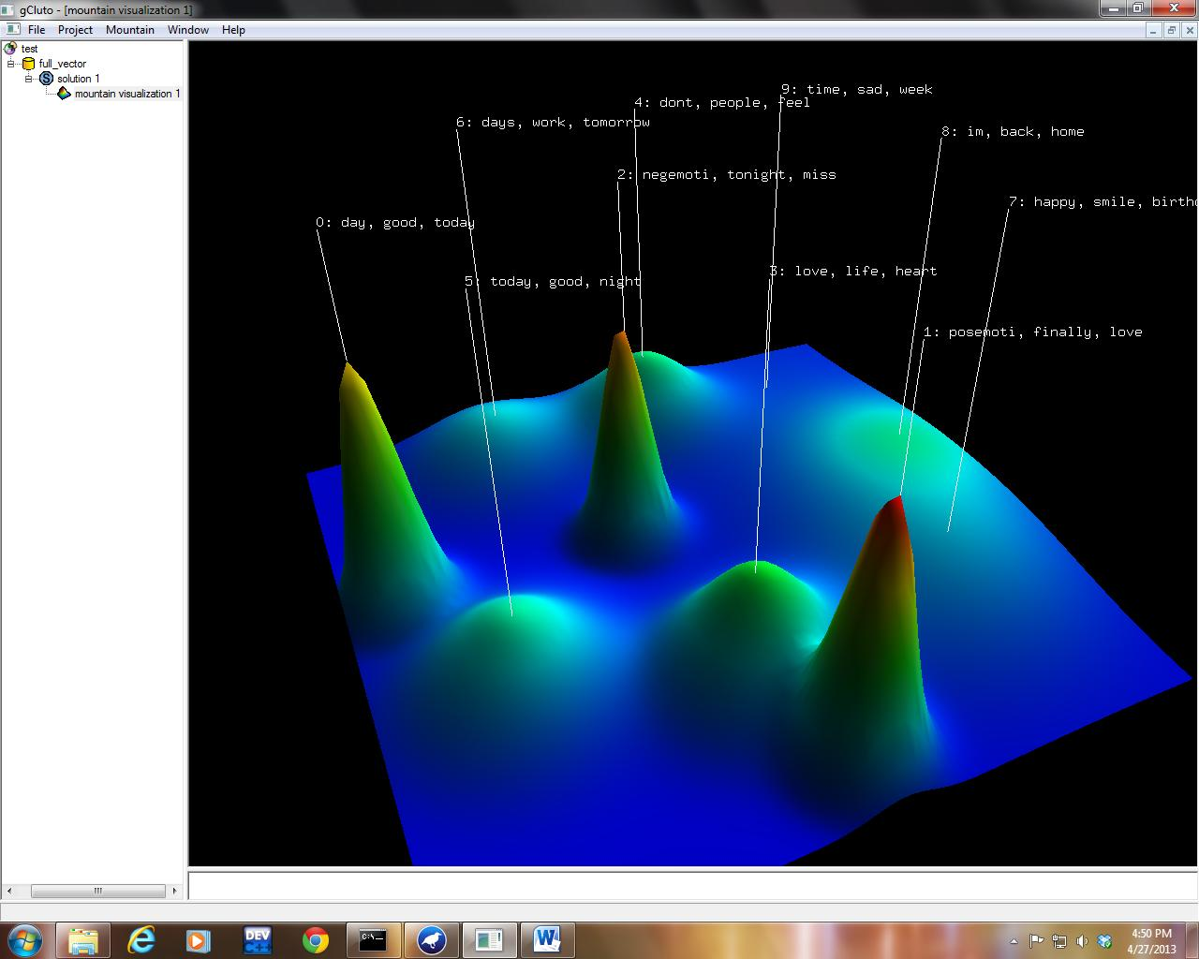
Data Exploration With CLUTO

Slide 11
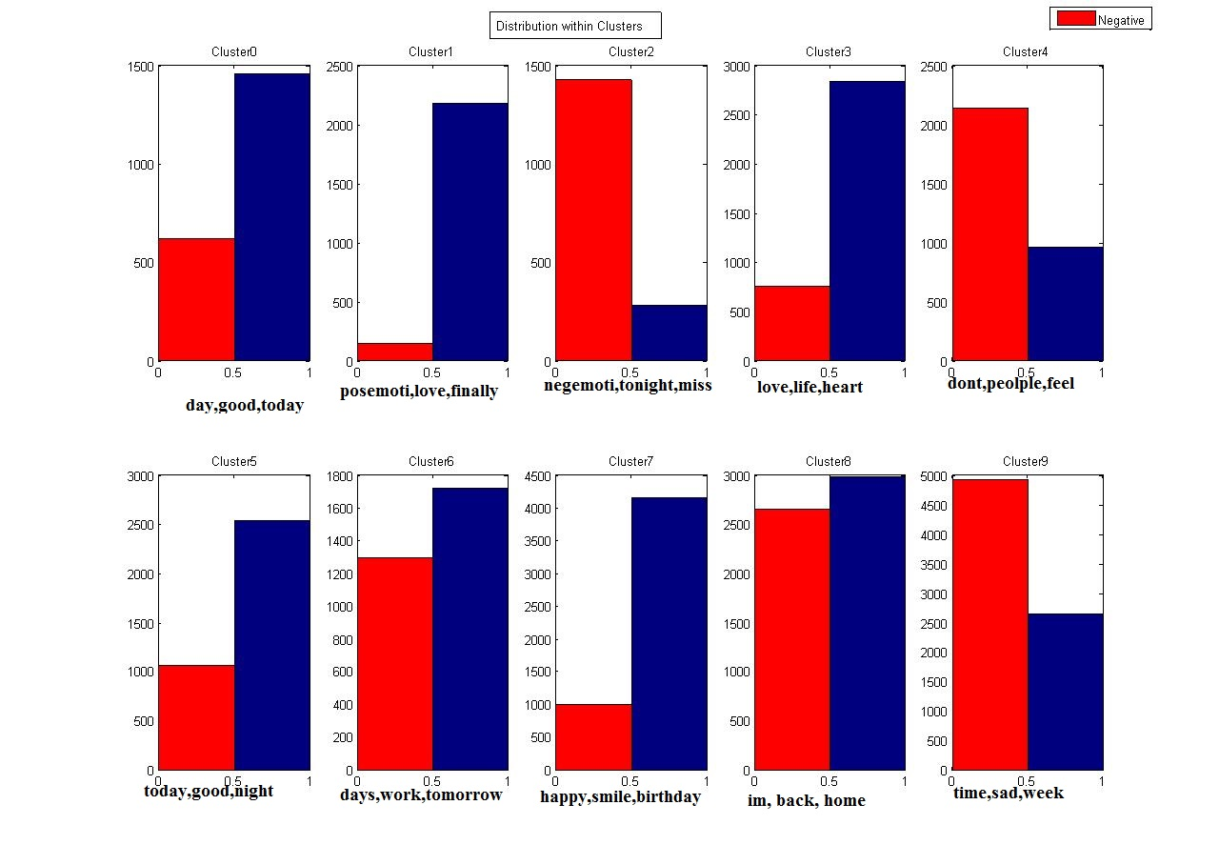
Data Exploration With CLUTO

Slide 12
Data Exploration With CLUTO
Positive Clusters: day,good,today, posemoti, finally,love,life,heart, today, happy, smile, birthday.
Negative Cluster: negemoti, tonight, miss, don’t, people, feel, time, sad, week.
Neutral Cluster: days,work,tomorrow, im,back,home.

Slide 13
Classification( Subset of Data 10%)
Classifier | Accuracy | Precision | Recall | F-Measure | ROC Area
Decision Trees | 0.637 | 0.695 | 0.637 | 0.612 | 0.704
Naïve Bayes | 0.6727 | 0.709 | 0.673 | 0.66 | 0.759
SVM | 0.7347 | 0.747 | 0.735 | 0.732 | 0.737

Slide 14
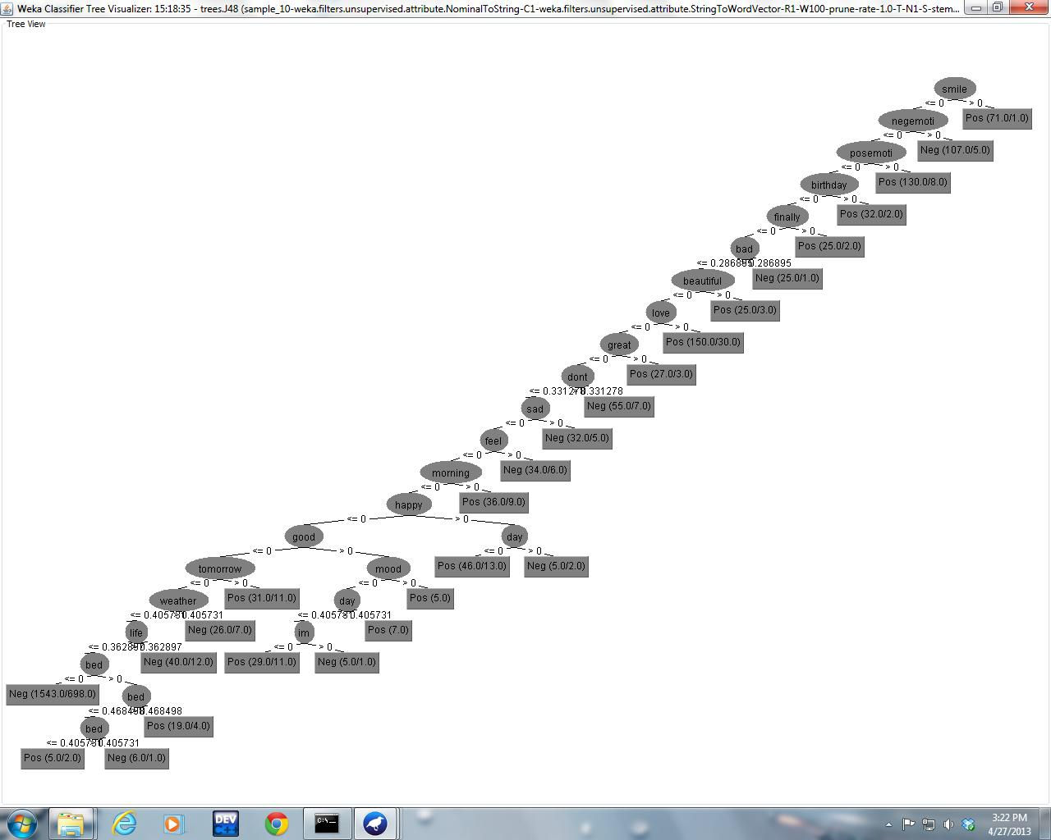
Classification( Subset of Data 10%)
Decision Tree on 10% of the Data

Slide 15
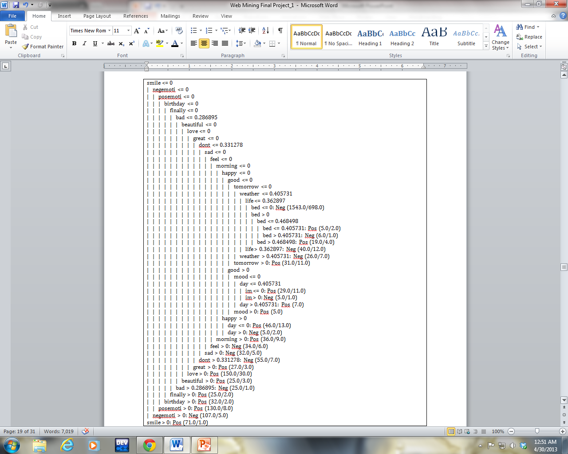
Classification( Subset of Data 10%)
Decision Tree on 10% of the Data

Slide 16
Experimentation Full Dataset Using Naïve Bayes
Correctly Classified Instances 18964 62.7989 %
Incorrectly Classified Instances 11234 37.2011 %
Kappa statistic 0.2577
Mean absolute error 0.372
Root mean squared error 0.6085
Relative absolute error 74.4068 %
Root relative squared error 121.695 %
Coverage of cases (0.95 level) 63.3155 %
Mean rel. region size (0.95 level) 50.5315 %
Total Number of Instances 30198
=== Detailed Accuracy By Class ===
TP Rate FP Rate Precision Recall F-Measure MCC ROC Area PRC Area Class
0.319 0.061 0.841 0.319 0.463 0.329 0.781 0.759 Neg
0.939 0.681 0.578 0.939 0.715 0.329 0.779 0.750 Pos
Weighted Avg. 0.628 0.370 0.710 0.628 0.589 0.329 0.780 0.754
=== Confusion Matrix ===
a b <-- classified as
4839 10317 | a = Neg
917 125 | b = Pos

Slide 17
Experimentation SVM on Full Dataset
Correctly Classified Instances 29692 78.6585 %
Incorrectly Classified Instances 8056 21.3415 %
Kappa statistic 0.5531
Mean absolute error 0.2134
Root mean squared error 0.462
Relative absolute error 43.6811 %
Root relative squared error 93.4678 %
Total Number of Instances 37748
=== Detailed Accuracy By Class ===
TP Rate FP Rate Precision Recall F-Measure ROC Area Class
0.663 0.122 0.8 0.663 0.725 0.77 Neg
0.878 0.337 0.779 0.878 0.826 0.77 Pos
Weighted Avg. 0.787 0.246 0.788 0.787 0.783 0.77
=== Confusion Matrix ===
a b <-- classified as
10620 5401 | a = Neg
2655 19072 | b = Pos

Slide 18
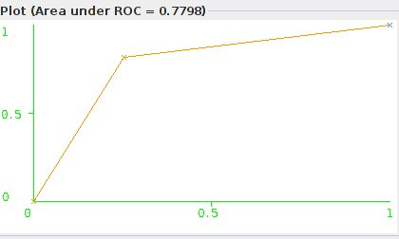
SVM Weka Results(Balanced Dataset)
Correctly Classified Instances 29822 79.0029 %
Incorrectly Classified Instances 7926 20.9971 %
Kappa statistic 0.58
Mean absolute error 0.21
Root mean squared error 0.4582
Relative absolute error 41.9945 %
Root relative squared error 91.6455 %
Total Number of Instances 37748
=== Detailed Accuracy By Class ===
TP Rate FP Rate Precision Recall F-Measure ROC Area Class
0.823 0.243 0.773 0.823 0.797 0.79 Neg
0.757 0.177 0.809 0.757 0.783 0.79 Pos
Weighted Avg. 0.79 0.21 0.791 0.79 0.79 0.79
=== Confusion Matrix ===
a b <-- classified as
15564 3356 | a = Neg
4570 14258 | b = Pos

Slide 19
Results Using SVM
Clasifier | Accuracy | Precision | Recall | F-Measure | ROC Area
20% sample | 0.76 | 0.761 | 0.761 | 0.761 | 0.761
10% sample | 0.7347 | 0.747 | 0.735 | 0.732 | 0.737
full dataset_unbalanced | 0.786 | 0.788 | 0.787 | 0.783 | 0.77
full_dataset_balanced | 0.79 | 0.79 | 0.79 | 0.79 | 0.79
SVM_python | 0.81 | 0.81 | 0.82 | 0.818 | -

Slide 20
Classification(Full Dataset using Python)
Number of Negative Tweets: 16021
Number of Positive Tweets: 16805
number of documents: 32826
number of words: 25098
number of words (average):
5.33244988728
Classifier | Accuracy | Precision | Recall | F-Measure | Parameters
Naïve Bayes | 0.73 | 0.684 | 0.879 | 0.77
KNN | 0.488 | - | - | - | K=20,top300
SVM | 0.81 | 0.81 | 0.826 | 0.8187 | Linear Kernel
Naïve Bayes | 0.742 | 0.7197 | 0.9046 | 0.8016 | Unbalanced Data

Slide 21
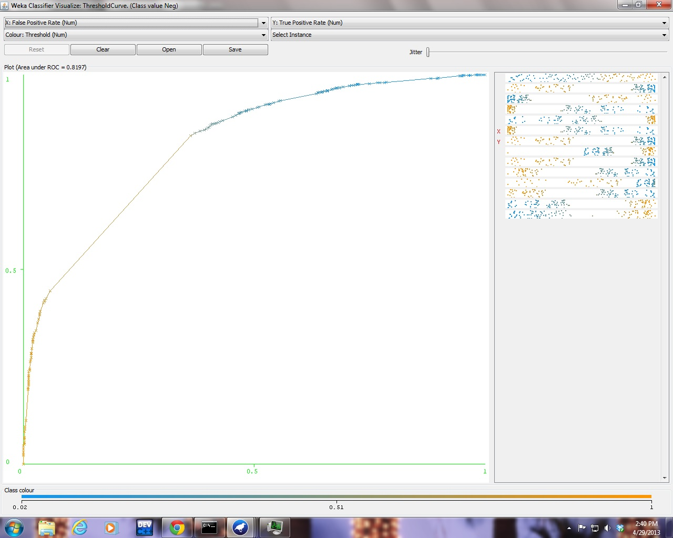
Results Using Binary Model for Documents
Classifier | Accuracy | Precision | Recall | F-Measure | ROC Area
Decision Trees | 0.741 | 0.751 | 0.742 | 0.739 | 0.82
SVM | 0.763 | 0.767 | 0.763 | 0.763 | 0.763
Decision trees vs SVM on Binary model
ROC curve for Decision Trees

Slide 22
Test Data Set
Preprocessed Tweet | Class
in london again cant wait to see my girlfriend negemoti | 0
negemoti | 0
days till prom still no date | 1
bored of this focusing on my work plan already gone weeks without a drop of alcohol and ive had enough passmethejd | 0
mins ago i was crying because i didnt wanna go work now im crying because my company has shut down and i dont have a job | 0
annoo i want to go soo frickin bad shitweather | 0
heady highminded lovers of pleasures more than lovers of god sad lonely Christians | 1
having a form of godliness but denying the power thereof from such turn away sad lonely Christians | 1
and everyday it feels like im losing you all over again missyousomuch | 0
listening to magic makes me tour depressed even though they didnt sing it waa | 0
prototype proton supported by sidney samson | 1
heart this once again robs working with amazing actors and director mtts | 1
heart squee vermont in one week for work of course but it still feels like a mini vacation to me craftbeer | 1
posemoti heart sums up my whole mood | 1
weeks from today ill be going home yay excited | 1
fallinhard yourthebest | 1
whole days to myself | 1
followers on tumblr | 0
on my math achievement test today | 1
birthday prezies from my daughter posemoti my first chane | 1

Slide 23
Conclusion
In this project, a proof of concept was implemented aimed at detecting emotions from tweets.
The ability of SVM to classify high dimensional data was evident by it obtaining an accuracy of ~81% on 10-fold crossvalidation on the entire corpus, Naïve bayes was able to produce an accuracy of only ~74%, while Decision trees was took an enormous amount of time to compute and had to ultimately be shut down.
When considered the Binary model for documents, the Decision tree algorithm performed much better than its counterparts. Its accuracy rose to ~74% from its previous value of ~68%. This is because the decision tree algorithm works much better on binary and nominal values than continuous values.
Although SVM was able to produce high accuracy on this data if a tweet contains words which the model has not yet seen , its performance cannot be . Also, the same words could be used to denote very different meanings and emotions, for example people use the term sad and happy in the same tweet. Also the model is currently not equipped for identifying Neutral tweets. This would be an interesting task for the future work.

